Slide 1
EP Assignment -1
- SAURABH KISHOR (19CS1100)

Slide 2
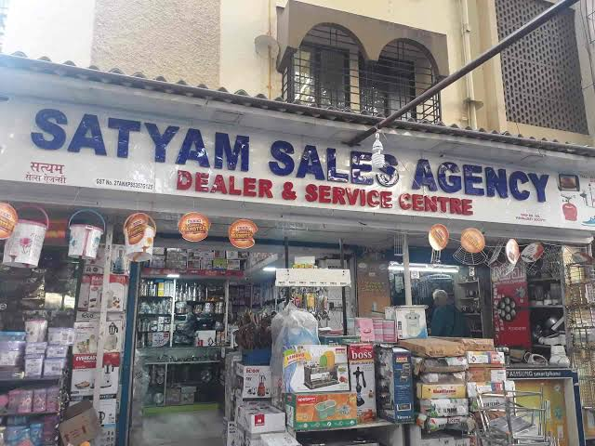
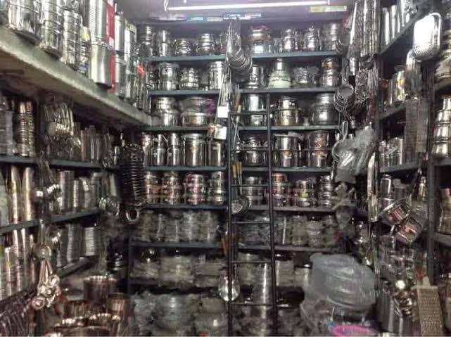
Home appliances Business

Slide 3
1. Why did you start a business?
I did start a business because-
Be your own boss Mindset:
1) I decide where finances go, what kind of company culture I want, and the quality of work that should be expected.
2) I choose my working hours, meaning I have complete control over when I work and when I don’t.
3) my current job doesn’t pay what I want.
Become an expert:
4) Instead of waiting for someone to give you a chance to be the best at something you’re passionate about, create your own opportunities.
5) Identified my passion: this means I won’t mind pursuing it after hours, Fulfillment of our vocational purposes.

Slide 4
Authority
As a business owner, I make decisions for myself. This offers me more authority and autonomy at work.
Flexibility
I choose to own a business because it offers flexibility. I can choose your work hours, including how much you work.
If you start a business, you can gain experience in fields such as management, finance, marketing, production and human resources.

Slide 5
Why didn’t you take up a job instead?
In a job, you earn a salary, but business owners can earn a salary and enjoy the profits of their business when it is successful.
Being a business owner does not require specific qualifications. There are many ways to learn how to start a business. but for Jobs have specific qualifications you must meet in order to work in that position. Qualifications may involve an educational degree, minimum years of experience and certifications that an employer deems necessary in order for you to perform well in a job role.

Slide 6

How did you come up with the idea for this business?
I had a floor space of at least 1500–2000 sft, in a commercial residential area. I think to start a business and analyse the Market overview, How big is the kitchen appliance industry, customer demands, profit margin etc then after Analysis i decied to start this business.

Slide 7
The success of a showroom depends on the variety of stock you maintain so i included different -different varieties of branded essential Kitchen appliances. ex:
• Microwave Oven -LG, Panasonic, Samsung..
• Wet Grinder -Panasonic, Elgi Ultra Grind.
• Induction Stove
• Gas Stove
• Cooker etc.

Slide 8
Who were the people who encouraged you and helped you shape your ideas?
Mom and Dad:
They understand my business’s idea plans, supprot and help me and encourage me to start my business.
one thing when I was a kid that taught me a lot about business.
My dad help me to Plan my business, studying the Market, Competitors, Location for Business.

Slide 9
Friend & relatives, bank: Funding source, bank loans, Advertising Plan, initial investment of Rs. 10 - 15 lacs.
Government and it’s staff: Obtain necessary permits and licenses.
wholesalers: To get the branded goods.
Buying directly from the wholesalers, I ordered any specific products of the brand that I think has a good demand.

Slide 10
When did you start your business?
4-5 years ago.
What are your strengths that make you keep doing what you are doing?
“Self-motivation” and “believe in myself” is my strengths that make me keep doing what I am doing.
Best customer service experience
Hassle free and customer friendly
Best available prices
Good communication and delivery arrangements

Slide 11
What’s special about your product or service?
Shop Top Kitchen Utensils and Appliances at lowest prices.
my shop can help you narrow down your choices based on your budget as well as other factors.
We deal in essential Kitchen appliances, including:
• Microwave Oven
• Wet Grinder
• Induction Stove
• Gas Stove
• Cooker

Slide 12
• Mixer grinder
• Chimney
• Coffee Maker
• Flask Toaster
• Juicer Maker
• Electric Kettle
• Dishwasher and more

Slide 13
What Makes your Services Standout?
We deal with all kinds of Consumer Electronics Kitchenware, and Household articles. With the best brands, competitive pricing, and customer satisfaction.
We offer 0% interest installment schemes.
When you choose to visit our kitchen appliances store, you can get exchange offers and other seasonal discounts and gifts.

Slide 14
Do you have plans to expand?
Yes, I have plans to expand and add some expensive items and electrical appliances like: freezers, refrigerators, washing machines, clothes dryers.
In modern era of online shopping I also wants to be the start an online selling model for a growth.
online delivery options.

Slide 15


